Slide 1
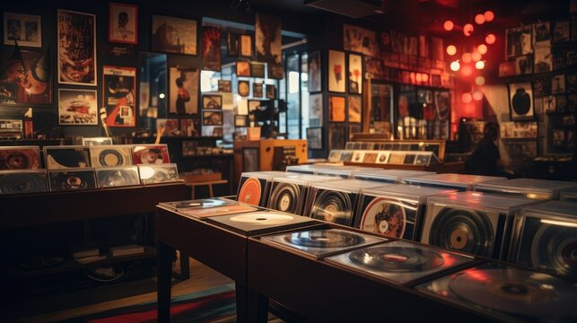
CHINOOK MUSIC STORE ANALYSIS
By – SHALAKYA SEN

Slide 2

ABOUT CHINOOK :-
Chinook Music Services is a premier name in the physical music records industry, dedicated to delivering exceptional musical entertainment to audiences around the world.
With a global network of retail outlets, distribution channels, and customer-focused services, Chinook provides music lovers with access to an unparalleled collection of physical media.
From timeless classics to contemporary hits, our extensive catalog spans every major genre, ensuring that every musical taste is catered to.
Beyond offering a wide selection, Chinook is committed to preserving the cultural value of physical music formats—vinyl, CDs, and special editions—helping collectors and audiophiles alike connect with music in its most authentic form.
Whether you're a casual listener or a dedicated fan, Chinook Music Services invites you to experience the richness of music through expertly curated content, high-quality products, and passionate service.

Slide 3
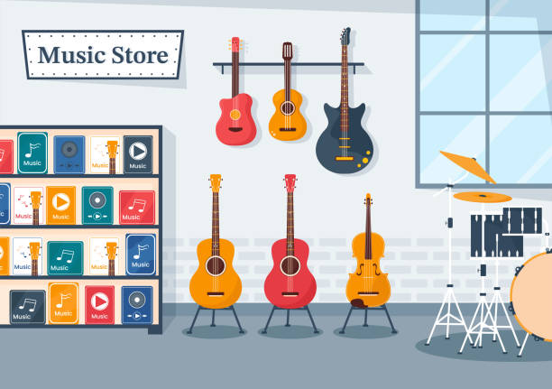
AGENDA :-
INTRODUCTION & OBJECTIVES
PROBLEM STATEMENT
DATABASE SCHEMA
CHINOOK DATA OVERVIEW
INSIGHTS
STRATEGY
CONCLUSION

Slide 4
INTRODUCTION & OBJECTIVES :-
Introduction - This project focuses on analyzing Chinook Music Store's data to provide key insights for informed decision-making in areas like marketing, inventory, and customer engagement. The music retail industry benefits immensely from data-driven strategies to understand customers and optimize offerings for increased success.
Objectives - The primary goal is to analyze Chinook Music Store's sales and customer data to uncover valuable patterns and trends. This will be achieved through:
1. Data Quality - Ensuring the data is accurate, complete, and consistent for reliable analysis.
2. Sales Performance - Identifying top-selling music, artists, and genres to inform inventory and promotion strategies.
3. Customer Analytics - Understanding customer demographics, purchasing habits, and loyalty to tailor marketing efforts.
4. Geographic Insights - Analyzing sales and customer distribution across different locations to identify key markets.
5. Strategic Opportunities - Recommending promotional focus areas and uncovering insights for customer retention and growth.
6. Database Enhancement - Improving the data structure for more effective analysis (e.g., adding release year).

Slide 5

PROBLEM STATEMENT
You are hired as a data analyst at Chinook, and your objective is to analyze music record sales data to gain insights and make recommendations for the company's strategy in the physical music market.
Chinook seeks to gain insights into customer purchasing behaviour and market dynamics in the music industry.
By analysing sales data, the company aims to identify top-selling tracks and artists, understand customer demographics, and assess purchasing trends across different genres and geographic locations.
This analysis will facilitate targeted marketing strategies, enhance customer retention efforts, and inform promotional initiatives for new record label albums based on genre performance and regional preferences.
Additionally, Chinook aims to develop risk profiles for customer segments to better predict churn and improve customer lifetime value modelling.

Slide 6
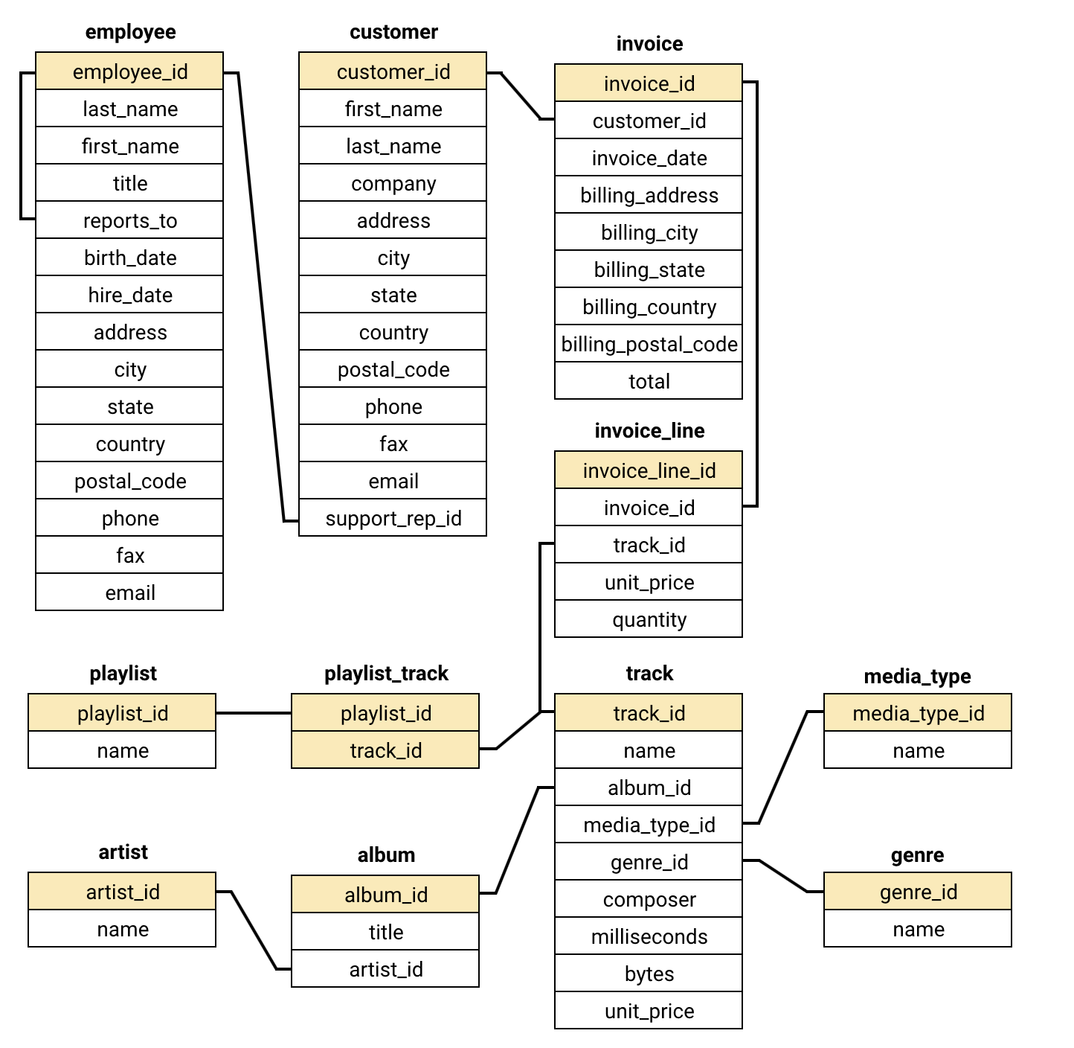
DATABASE SCHEMA :-

Slide 7

DATA OVERVIEW
The dataset comprises 11 detailed tables, each containing structured information covering different facets of Chinook Music Services’ operations.
Chinook caters to a diverse global customer base, with users located in 53 cities across 24 countries.
Its music catalog features tracks from 25 distinct genres including Rock, Metal, Jazz, Classical, and more demonstrating the company’s dedication to musical variety.
The catalog includes 275 artists and 347 unique albums, offering listeners a rich and varied selection of music that appeals to a wide range of tastes and preferences.
Detailed information is provided for both albums and their corresponding artists, allowing for in-depth exploration of musical content and artist contributions.
The invoice table captures all customer transactions, offering a complete record of sales activity, including dates, purchase amounts, customer details, and purchased items.
The dataset provides valuable insights into global music preferences, purchasing behavior, and the performance of various genres and artists.

Slide 8
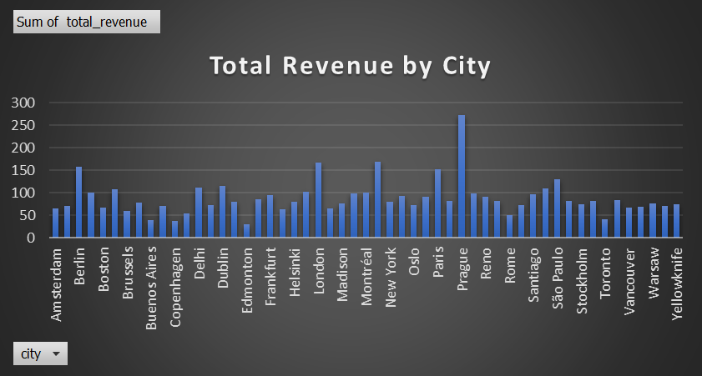
TOTAL REVENUE FOR EACH CITY
Prague (Czech Republic) stands out with the highest total revenue, significantly surpassing all other billing cities.
Mountain View (USA) and London (United Kingdom) follow as the next highest revenue-generating cities, with relatively close total revenue figures.
Several European cities, including Berlin (Germany) and Paris (France), contribute substantial total revenue, ranking among the top performers.
While many cities show similar total revenue in the lower range, Ottawa (Canada) and Reno (USA) exhibit some of the lowest total revenue among the displayed billing cities.

Slide 9
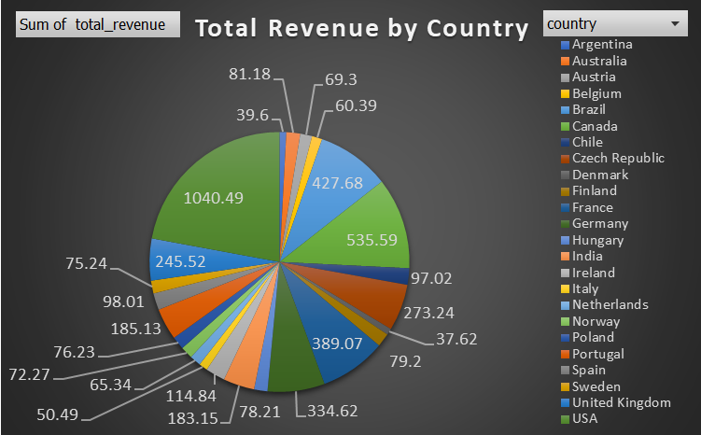
TOTAL REVENUE FOR EACH COUNTRY
USA leads significantly, contributing 1040.49 stands out with the highest total revenue, significantly surpassing all other billing countries.
France, Germany, and the UK form a strong mid-cluster, each generating between 389 to 535 in revenue, showing solid European market performance.
Emerging markets like India (33.02) and Chile (30.72) contribute modestly, suggesting potential areas for strategic growth or deeper audit focus.

Slide 10
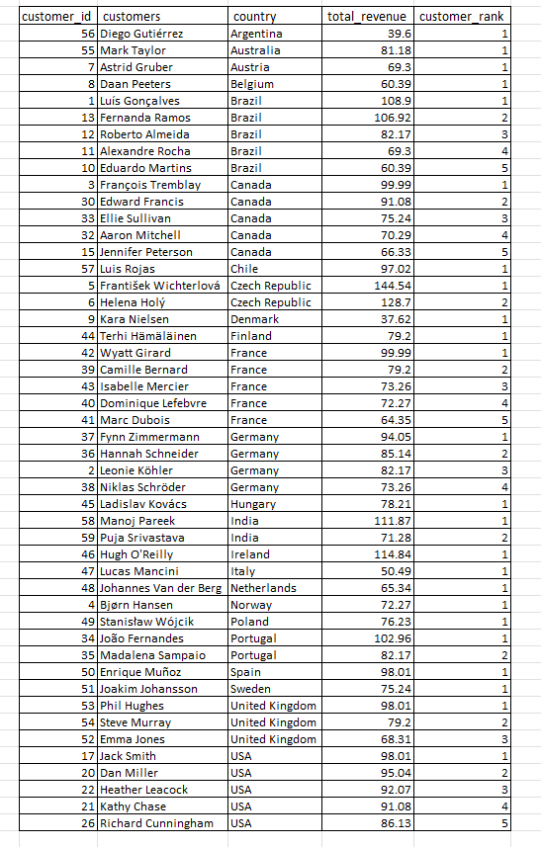
Top 5 Customers By Total Revenue In Each Country
The highest revenue-generating customer is František Wichterlová from the Czech Republic, with a total revenue of 144.54.
Customers are spread across various countries, with notable contributions from Brazil, the USA, Canada, and the Czech Republic.
Brazil has a significant number of top customers, with multiple entries in the top revenue rankings.
Many countries have customers with similar revenue figures, indicating a broad and relatively even distribution of high-value customers.
The USA has several high-revenue customers, with Jack Smith leading the list at 98.01 in revenue.

Slide 11
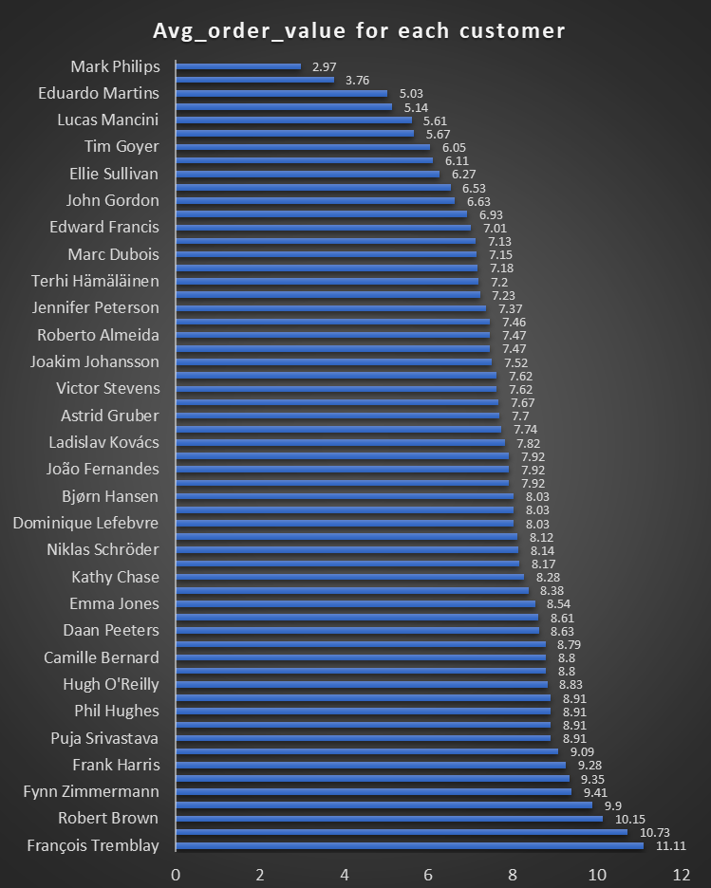
Average Order Value for each Customer
François Tremblay has the highest average order value at 11.11, indicating that this customer spends more per order compared to others.
Customers like Helena Holý and Robert Brown also have high average order values above 10, showing they are likely to be high-value customers.
A significant number of customers have average order values ranging between 7 and 9, suggesting a moderate spending pattern across the customer base.
Customers like Kara Nielsen and Mark Philips have significantly lower average order values, with Mark Philips having the lowest at 2.97, indicating more frequent but smaller purchases.
The data shows a wide range of average order values, reflecting diverse spending behaviors among the customers.

Slide 12
Customer Distribution Vs Spending Behavior by Country
USA has the most customers (13), but spending per customer is relatively low (73.2).
Ireland, with just 1 customer, shows high spending (98.1).
Netherlands balances both with 8 customers & 66.3 average spend.
Insights - Retention is strong, but revenue optimization could be improved.

Slide 13
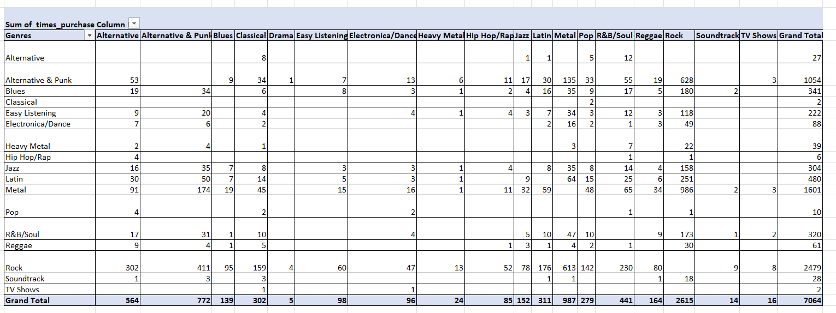
Genre Affinity Analysis(Genres frequently purchased together by customers )
Metal and Rock, along with Alternative & Punk and Rock, are often purchased together, indicating shared fan bases.
Latin and R&B/Soul also pair with Rock, suggesting potential for cross-genre promotions.

Slide 14
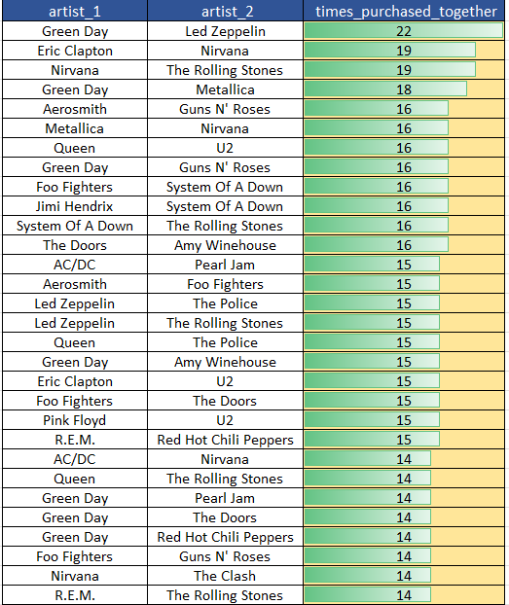
Artist Affinity Analysis
Green Day and Led Zeppelin, as well as Nirvana and The Rolling Stones, are often bought together, showing cross-genre appeal.
Co-purchases of artists like System Of A Down with Foo Fighters and Queen with The Police highlight popular listener combinations.

Slide 15
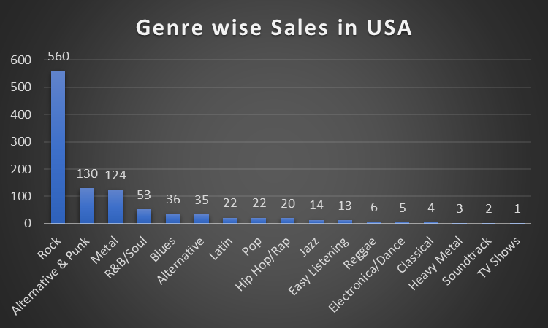
Sales by Genre Analysis in USA
Rock music generates the highest total sales in the USA, with a value of 555, significantly outperforming all other genres.
Alternative & Punk and Metal follow as the next highest-grossing genres in the USA, achieving similar total sales figures of 130 and 124 respectively.
The remaining genres contribute considerably less to the total sales, with TV Shows generating the lowest at a value of 1, indicating a smaller market share compared to Rock.

Slide 16
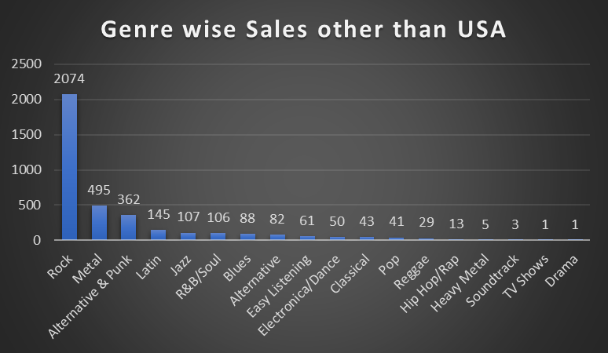
Sales by Genre Analysis in other countries.
Rock music accounts for the largest portion of sales with a significantly higher value of 2074, highlighting its widespread financial success globally.
Metal and Alternative & Punk are the next strongest genres in terms of sales internationally, mirroring the US trend but with greater revenue.
A wider variety of genres contribute in regions outside the USA, including Latin, Jazz, R&B/Soul, Blues, Alternative and others although their individual sales are lower than Rock and Metal.

Slide 17
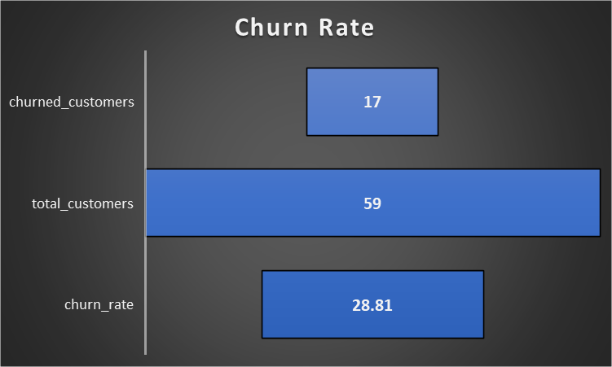
Churn Rate
A customer is considered to be a churned customer if they have not made any purchase in the last 6 months.
Churn Rate Insight: Out of 59 total customers, 17 have churned, resulting in a churn rate of 28.81%, which implies that almost 2 in every 7 customers are inactive or churned.
Retention Signal: A churn rate nearing 30% may indicate potential issues in customer satisfaction, onboarding, or product-market fit worth deeper segmentation or feedback analysis.
Actionable Strategies Needed: Implement improved customer service and launch targeted campaigns (promotions, events) to reduce churn and attract new customers effectively.

Slide 18
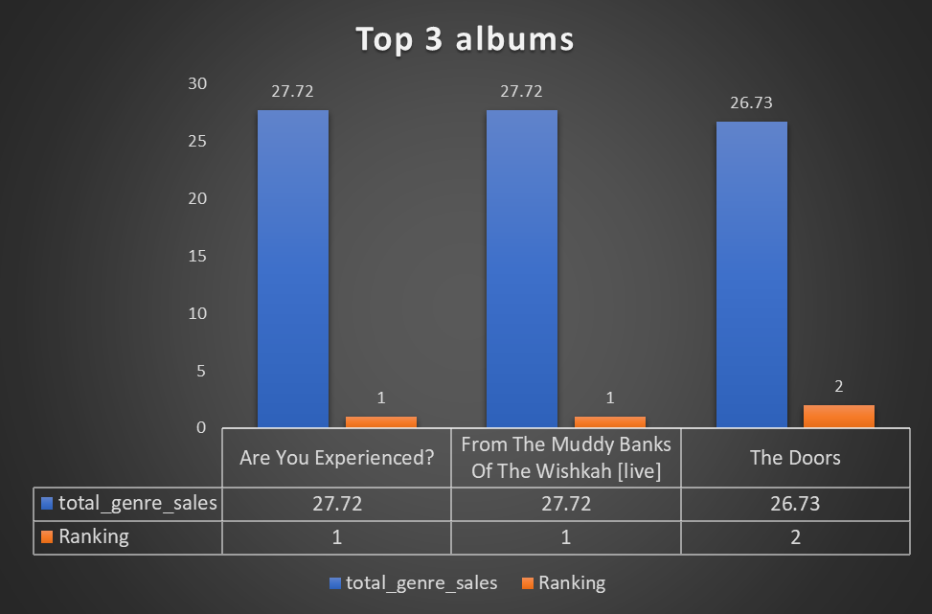
Top 3 Albums - prioritized for advertising and promotion in the USA based on genre sales analysis
Genre Popularity: Rock is the dominant genre with the highest total sales figures. The top three albums all belong to this genre, indicating a strong market preference for Rock music in the USA.
Sales Figures: The selected albums have the highest total genre sales, making them strong candidates for promotion.
Given the strong sales performance of these albums in the Rock genre, they should be prioritized for advertising and promotion in the USA to capitalize on their popularity.

Slide 19

Overall Strategy
Focus on High-Performing Genres: Given the consistent dominance of Rock in both the USA and other markets, and the strong performance of R&B/Soul in the USA, prioritize marketing and inventory for these genres in the physical music market.
Address High Churn in Specific Regions: The alarmingly high churn rates (100%) in several European and South American countries (e.g., Argentina, Belgium, Italy) demand immediate investigation into localized issues and the implementation of targeted retention strategies.
Leverage Long-Term Customer Value: Recognize that long-term customers exhibit significantly higher purchase frequency, basket size, and overall spending. Implement loyalty programs and engagement initiatives to nurture these valuable relationships in the physical market.
Explore Product Affinity for Bundling: The co-purchase patterns of genres like Rock, Metal, and Alternative & Punk suggest opportunities for creating physical product bundles or in-store recommendations to encourage cross-selling and increase basket size.

Slide 20

Conclusion
Data Overview: Chinook Music Services’ dataset of 11 detailed tables, covering global sales across 53 cities in 24 countries and a catalog of 275 artists and 347 albums across 25 genres, provides a solid foundation for data-driven strategies in the physical music market.
Genre Promotion Based on Sales Insights: Focus on promoting top-performing genres like Rock and Alternative & Punk in the USA, while adapting to regional trends such as Metal's global appeal.
Cross-Selling Through Purchase Patterns: Use co-purchase data to identify genre and artist affinities, enabling effective cross-selling strategies that boost order value and revenue.
Customer Retention for Long-Term Value: Reduce churn by targeting high-value, long-term customers with personalized campaigns that foster loyalty and maximize lifetime value.
Sustained Growth Through Data-Driven Strategy: By leveraging sales insights, purchase behavior, and customer data, Chinook can enhance genre marketing, optimize cross-selling, tailor regional approaches, and drive long-term growth in the physical music market.

Slide 21


